Slide 1
Attention
Following a brain injury

Slide 2
Defining Attention
Aside from being awake and alert, one of the most important cognitive abilities is being able to pay attention or concentrate on important things happening around us.
Focused
Sustained
Selective
Alternating
Divided
Levels of Attention
Notes:
Attention serves as a gatekeeper; in order to prioritize and determine which cognitive resources are most important; attention helps us decide what is more important

Slide 3
Focused Attention
the ability to focus on one thing over a BRIEF period of time
Notes:
Turning to a loud noise, looking at a billboard while driving, noticing you are cold. You have to focus long enough to pay attention to it.

Slide 4
Sustained Attention
the ability to focus on one thing over a period of time
Notes:
Reading a book, watching a TV show, presentations
Paying attention and MAINTAINING it Often after injury we hear that individuals struggle watching TV and reading, and this is why…they will be watching TV but their mind will wander because it doesn’t have the ability to attend and then when they do try to watch again they will get lost or confused and get frustrated.

Slide 5
What to look for, Sustained Attention
Difficulty staying on task when working independently
Difficulty listening across the duration of a conversation/lesson/TV Show
Inability to complete tasks

Slide 6
Selective Attention
the ability to focus on one thing despite distractions
Notes:
can often sustain if they are not in a distracting environment but once distractions are presented they will struggle Watching TV: okay if everyones quiet, if someone gets up and answers the door they get distracted and confused/lost

Slide 7
What to look for, Selective Attention
Difficulty following a conversation and ignoring background noise
Reduced concentration caused by auditory or visual distractors
Difficulty concentrating caused by fatigue, worry or sadness

Slide 8
Alternating Attention
the ability to shift attention from one thing to another
Notes:
Talking on the phone and answering the questions of someone who comes in the room. Reading a recipe and stirring a pot. Filing and answering the phone We do different things to help us; leave a place holder (filing example) I’m going to mark that spot while I answer the phone Might say to the person on the phone “where were we?”

Slide 9
What to look for, Alternating Attention
Leaving tasks incomplete after interruption

Slide 10
Divided Attention
the ability to focus on multiple things at the same time
Notes:
Turning down the radio when you are lost! We don’t need our ears to find it; but listening to the radio is pulling our attention away so it is easier for us to focus when we turn down the radio
email, talking, web, TV, Individuals w.out BI struggle with this as well…neuropsych said “he doesn’t believe in multi-tasking” really is not the ability to…one is suffering more than the other we just don’t realize it.

Slide 11
What to look for, Divided Attention
Difficulty focusing on more than 1 thing at a time
Difficulty engaging in 2 tasks at once

Slide 12
Accommodations for Attention
Reduce auditory and visual distractions
Notes:
Best example I think would be a police officer with lights and sirens on then trying to have a conversation; turn all of that off and then talk.

Slide 13
Accommodations for Attention
Use visual aids to help with focus
Notes:
83% of what we learn comes from SIGHT. VISUALs, VISUALs, VISUALs! But, not distracting ones; ones to help enhance learning/attention…for example, the summary of notes after a doctors appointment can be very helpful to reference after and the next day to review…and then have individual say what when on in their own words to gauge comprehension

Slide 14
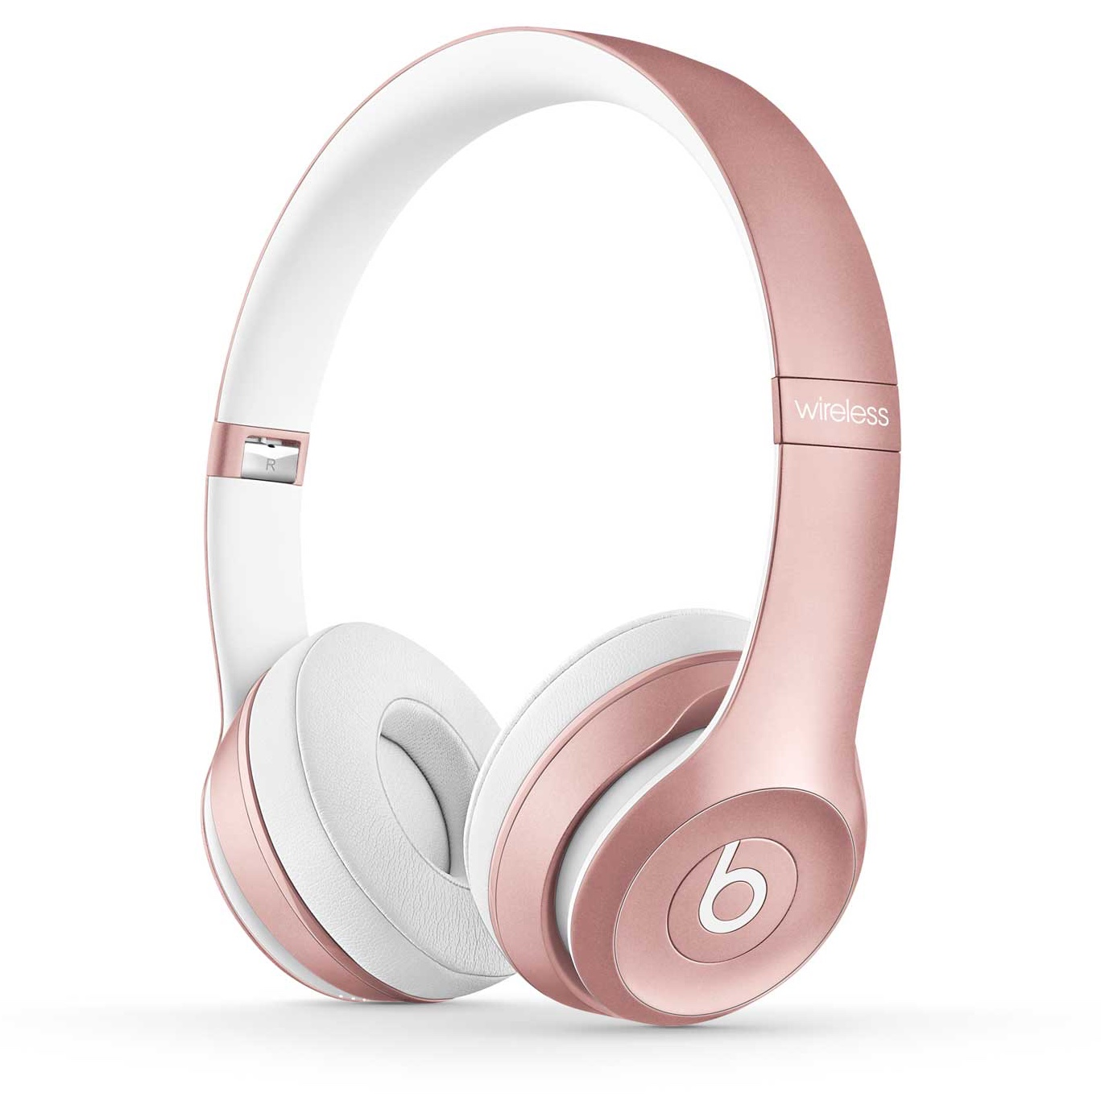
Accommodations for Attention
Work in quiet/non-distracting places or wear earphones to drown out noise

Slide 15
Accommodations for Attention
Break larger tasks into smaller, written down steps
Notes:
4 is the ideal number! Less, but no more than 4 steps when possible!

Slide 16
Accommodations for Attention
Use highlighters or color coding when following along with handouts

Slide 17
Accommodations for Attention
Take frequent “brain breaks”

Slide 18
What is a Brain Break?
A brain break is just what it sounds like: a break from whatever you are focusing on.
Short brain breaks during work time have been shown to have real benefits, they reduce:
stress
anxiety
frustration
Notes:
And increase productivity and focus! They can range from 5-30 minutes; make sure to set a timer if you are worried you will fall asleep!

Slide 19
Accommodations for Attention
Use a recorder to help remember important details

Slide 20
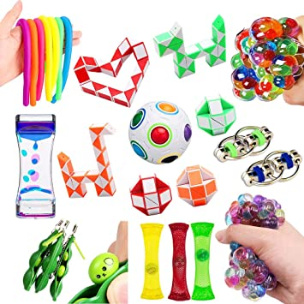
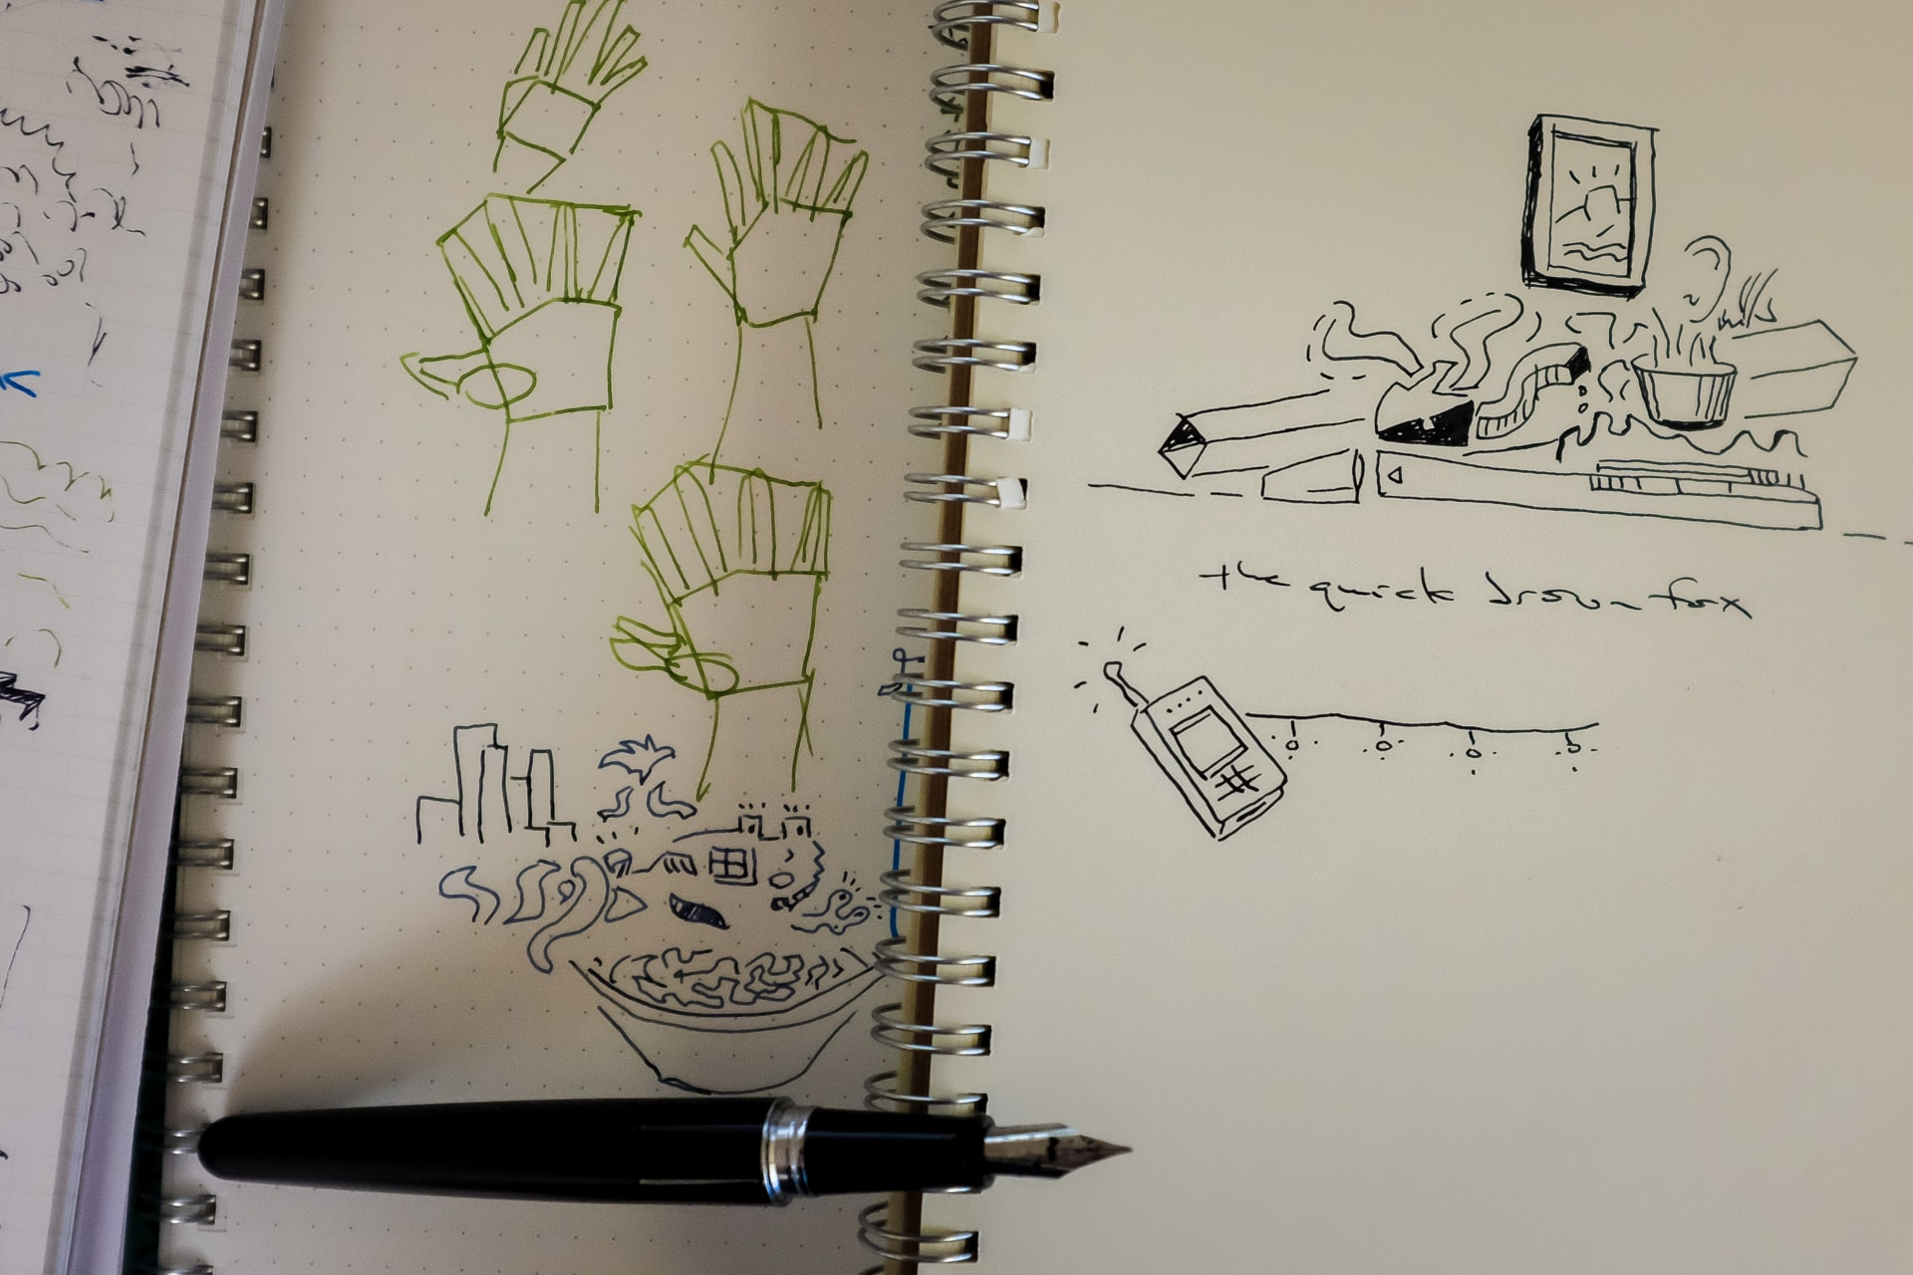
Accommodations for Attention
Try using doodling or fidget devices to stay focused

Slide 21
Accommodations for Attention
Schedule appointments during most alert time frames
Notes:
For majority of people this will be in the morning but can be different for all!

