Slide 1
Emotional Dysregulation
Following a brain injury

Slide 2
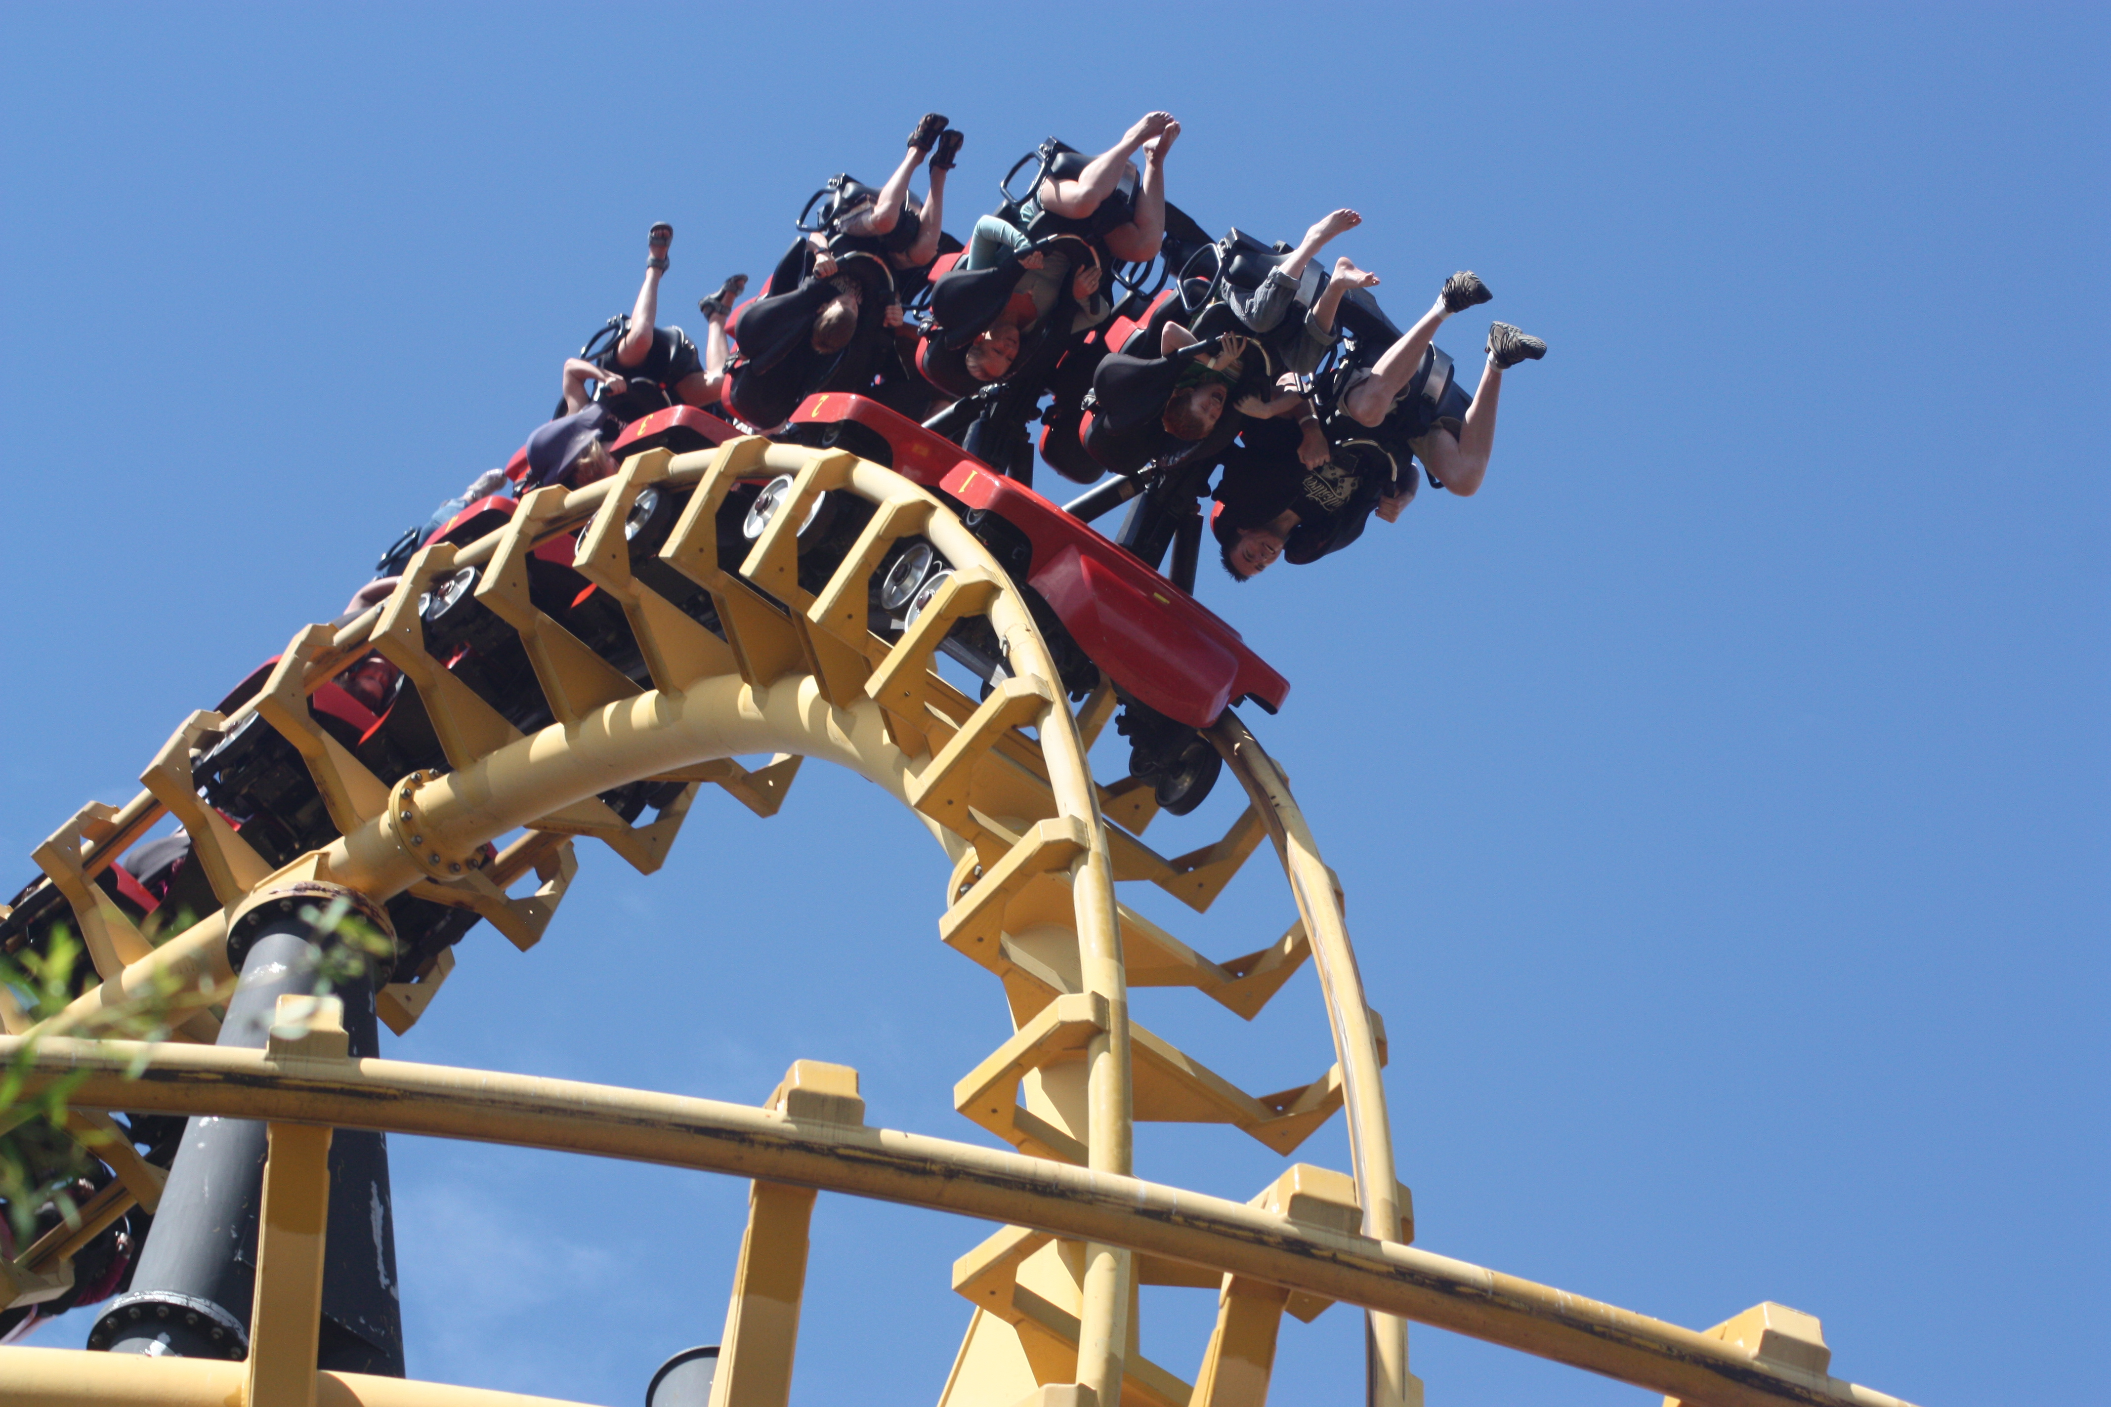
Defining Emotional Dysregulation
Emotional dysregulation means moods and emotional reactions are unstable and difficult to manage.

Slide 3
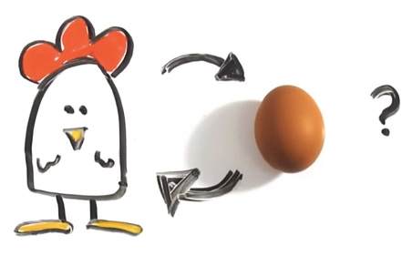
Emotional and Behavioral Changes
Caused by some mix of:
  Direct consequence of injury to the brain (particularly if regions involved in emotional processing are affected)
  Difficulties coping with problems experienced following the brain injury
  Pre-existing/Co-occurring emotional difficulties

Slide 4
Emotional/Behavioral Changes
Impulsivity, Irritability, Impatience
Social skills problems
  Inappropriate behavior
  Inability to inhibit remarks
  Inability to recognize social cues
Reduced self-esteem/over inflated sense of self
Stress/anxiety/frustration and reduced frustration tolerance

Slide 5
Behavioral Challenges
Poor response to traditional behavioral modification
Lack of awareness of own behavior
Lack of impulse control
Disinhibited behaviors that could disenfranchise friendships/ impact on school life
Notes:
It does not work to reward or punish a skill that is not in place

Slide 6
ABCs of Behavior
Antecedents—the before
  Triggers-emotions, social relationships, environment, events
Behavior—the actual behavior
  Able to SEE or OBSERVE
    Anger is not a behavior—yelling, swearing, hitting are
Consequences—the afterward
  Can either increase or decrease

Slide 7
Hidden Message to Behavior
Three main messages behind behavior:
An unmet need
  Emotional discomfort, physical pain, lack of resources
Expression of mood
  Angry, frustrated, sadness, confusion, loneliness
Response to stimulation
  Too little (boredom)
  Too much (over-stimulation)

Slide 8

Don’t be a Jellyfish!
Concrete and Consistent
Schmoozing it along with individuals with brain injury is a recipe for disaster

Slide 9
Focus on the Positive
Individuals with brain injury respond best to positive reinforcement
  Negative reinforcement and punishment are the least effective
Notice and encourage appropriate behavior FREQUENTLY

Slide 10

What to Look For..
Saying or doing things without thinking

Slide 11
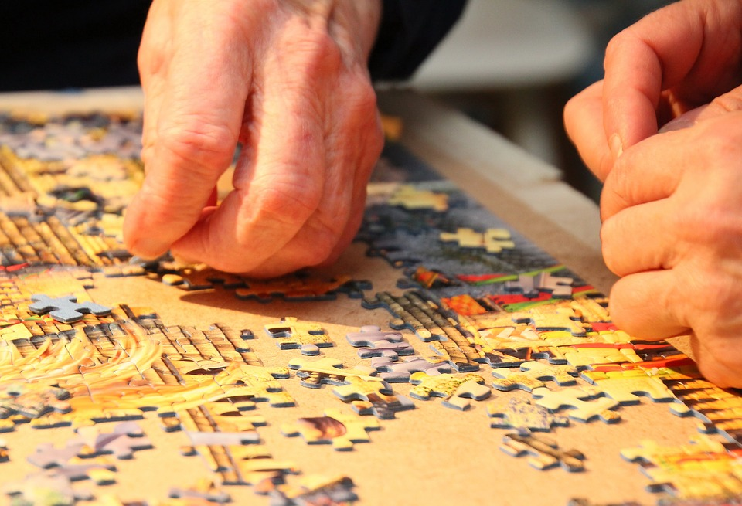
What to Look For..
Difficulty knowing when to stop an activity

Slide 12

What to Look For..
Doing things quickly or without regard for safety

Slide 13

What to Look For..
Moods shifting rapidly such as a sudden urge to yell or cry

Slide 14
What to Look For..
Intention and behavior may be disconnected such as laughing at a sad story

Slide 15

Accommodations for Emotional Dysregulation
Use mindfulness techniques (see mindfulness page for ideas)

Slide 16

Accommodations for Emotional Dysregulation
Pay attention to what is happening in your body when you feel agitated. For example, are you tapping your foot, clenching your fists?

Slide 17

Accommodations for Emotional Dysregulation
Ask for a short break

Slide 18

Accommodations for Emotional Dysregulation
Write down important information before you go into emotional situations

Slide 19
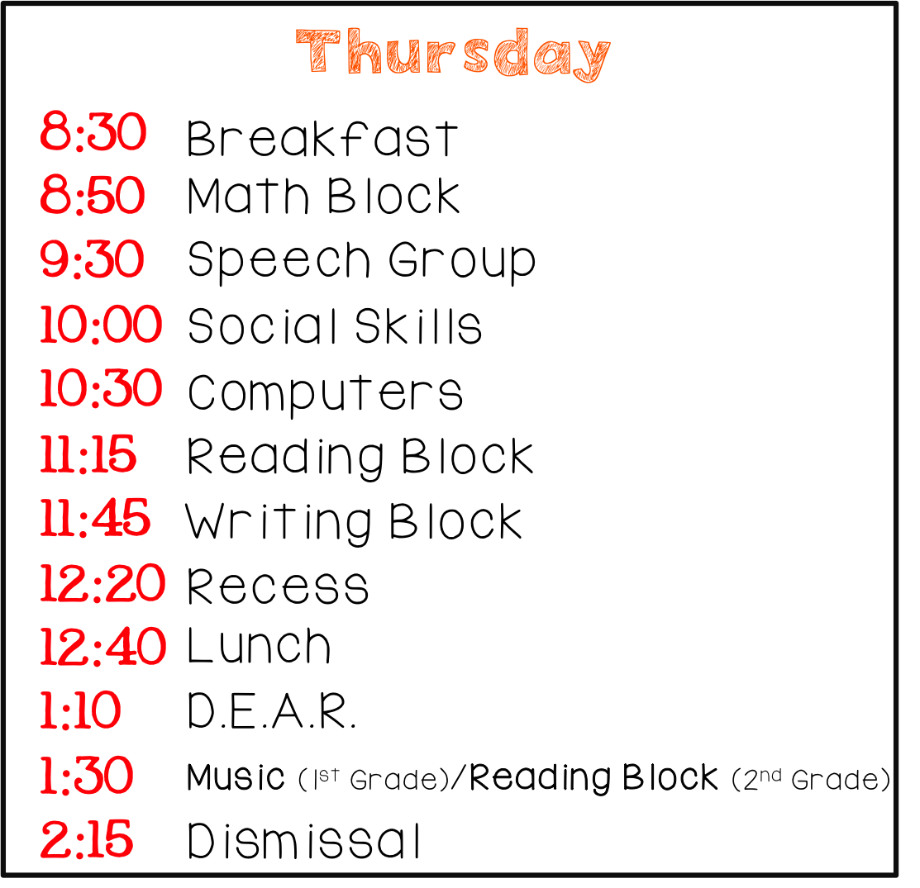
Accommodations for Emotional Dysregulation
Create a daily schedule to reduce feeling overwhelmed
Notes:
This example is for an elementary classroom but it can help if you think of your life like that!

Slide 20

Accommodations for Emotional Dysregulation
Make a list of people that make you feel safe and heard. Reach out to them when needing support

Slide 21

Accommodations for Emotional Dysregulation
Caregivers - the most important thing you can do is remain calm yourself, do not react to the person’s emotions. You can gently guide the person to a quiet area to help them regain control.
Notes:
This is more of a tip for caregivers but want you to be aware of this as something we are telling caregivers in case it happens to you!

