Slide 1
Fatigue
Following a brain injury

Slide 2
Defining Fatigue
Fatigue is a continual state of mental tiredness. Fatigue can occur after physical activity but most commonly after mental activity

Slide 3
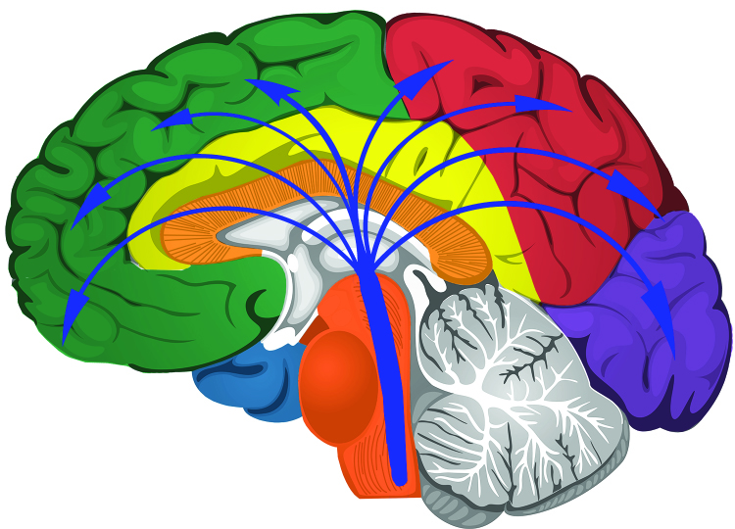
Primary vs Secondary Causes
Primary Causes
Directly from injury to parts of the brain controlling arousal, attention, and response
Secondary Causes
Factors that exacerbate fatigue such as:
Sleep
Disturbances
Pain
Stress
Anxiety
Depression

Slide 4
Common After Brain Injury
Studies show as many as 70% of individuals with brain injury complain of fatigue.
Often called the MOST debilitating consequence, but it’s not always understood.
Check out our Webinar Wednesday called: Fatigue Pie for more information!

Slide 5
What to Look For..
Withdrawn, short answers

Slide 6

What to Look For..
Slowed responses/thinking

Slide 7

What to Look For..
Loss of appetite

Slide 8

What to Look For..
Slower movement and speech (dull tone)

Slide 9
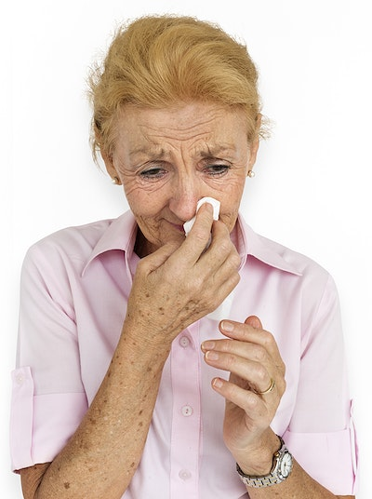
What to Look For..
Irritability, anxiety, crying episodes

Slide 10
What to Look For..
Increased forgetfulness

Slide 11

What to Look For..
Lack of motivation and interest

Slide 12

Accommodations for Fatigue
Organize routines around the times of day you feel your best

Slide 13

Accommodations for Fatigue
When you first start feeling tired, STOP and REST!

Slide 14


Accommodations for Fatigue
Reduce exposure to bright lights and loud noises

Slide 15

Accommodations for Fatigue
Schedule rest periods throughout your day

Slide 16

Accommodations for Fatigue
Keep your home and work environments uncluttered

Slide 17

Accommodations for Fatigue
Use assistive technology/mechanical aids

Slide 18

Accommodations for Fatigue
Reduce stress

Slide 19

Accommodations for Fatigue
Avoid or limit alcohol use

Slide 20

Accommodations for Fatigue
Ensure you are getting plenty of sleep

Slide 21

Accommodations for Fatigue
Talk to your provider about the role medication can play in fatigue

Slide 22

Accommodations for Fatigue
Talk to your provider if your fatigue effects your daily functioning

Slide 23
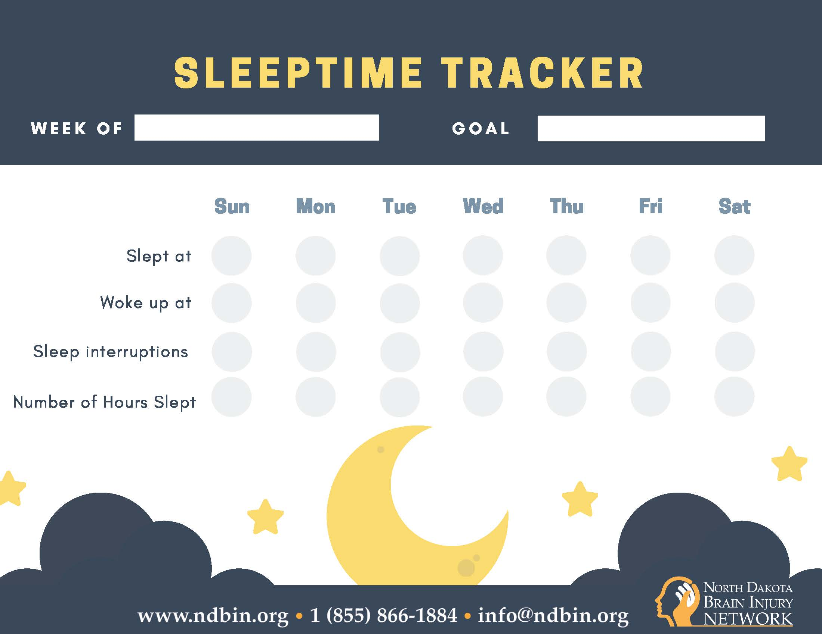
NDBIN Fatigue Resources
Notes:
https://www.ndbin.org/assets/4114-17612/medication-prescribed.pdf

Slide 24
NDBIN Fatigue Resources
https://www.ndbin.org/events/webinars
Fatigue Pie
December 4, 2019
Rebecca Quinn, LMSW, CBIST
Rebecca is the Program Director for the NDBIN and is considered the statewide expert on brain injury. She explained the barriers fatigue causes to individuals with brain injury and strategies to help overcome those barriers.
Recording | CEU Request
Notes:
https://www.ndbin.org/assets/4114-17612/medication-prescribed.pdf

