Slide 1
Definition of Goals
A goal is an observable and measurable end-result that you intend to achieve or accomplish. A well-planned goal also includes some sort of timeframe.

Slide 2
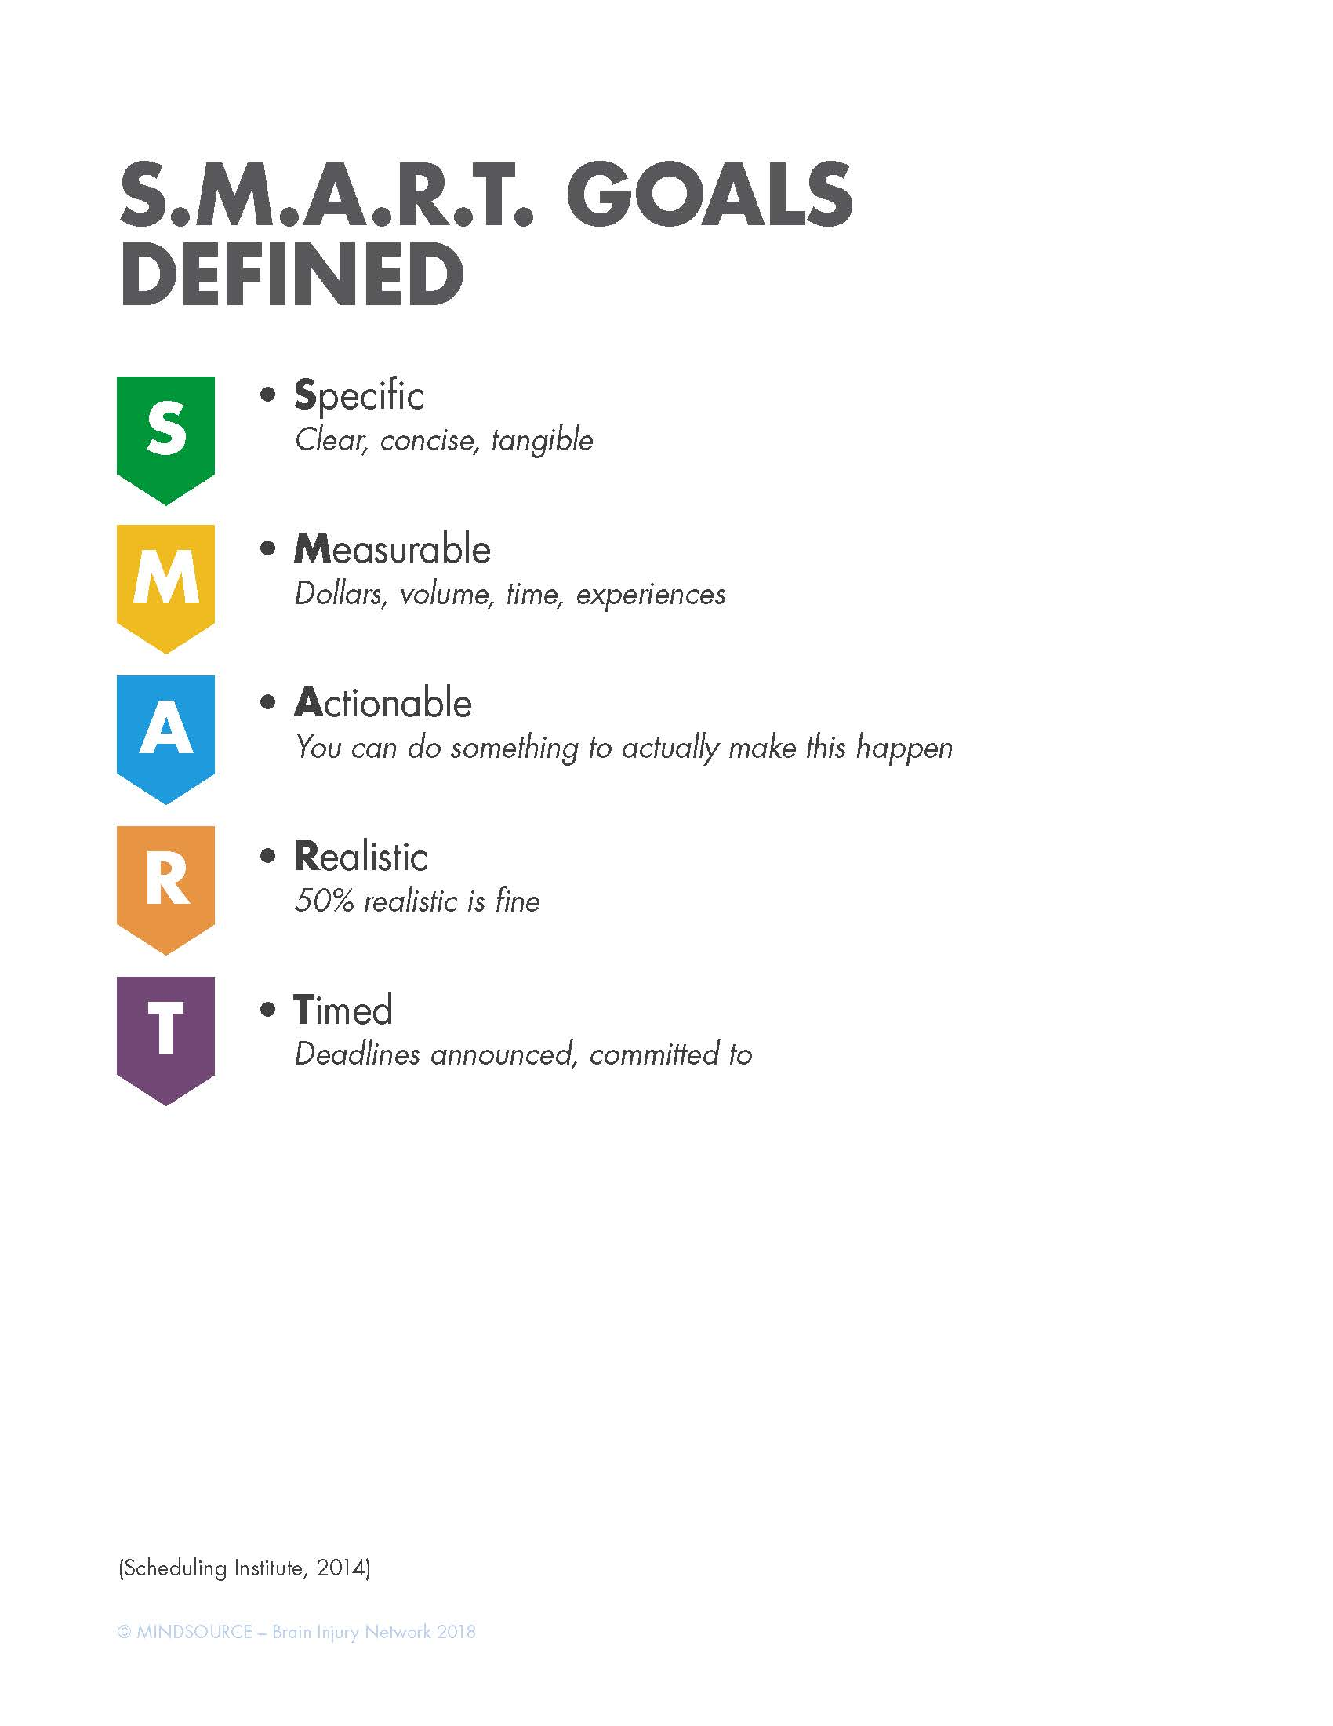
SMART Goal Development

Slide 3
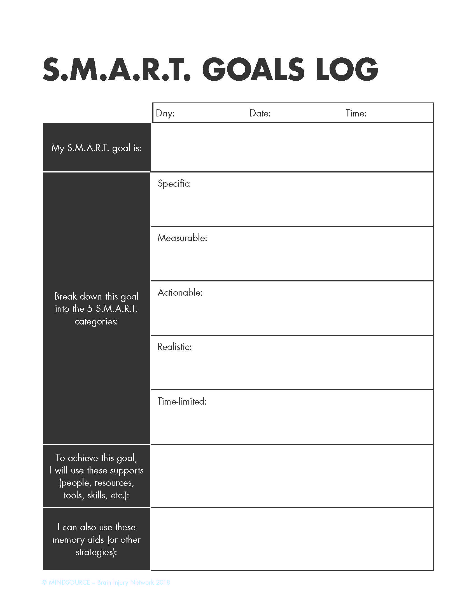
SMART Goals Log

