Slide 1
Impulsivity/Inhibition
Following a brain injury

Slide 2
Defining Impulsivity
Impulsivity is the conscious or unconscious inability to suppress or refrain from engaging in an action or thought.

Slide 3
Very Common
Problems with impulsivity are very common in individuals with brain injury. It is important to remember that the impulsivity is at fault, not the person.

Slide 4
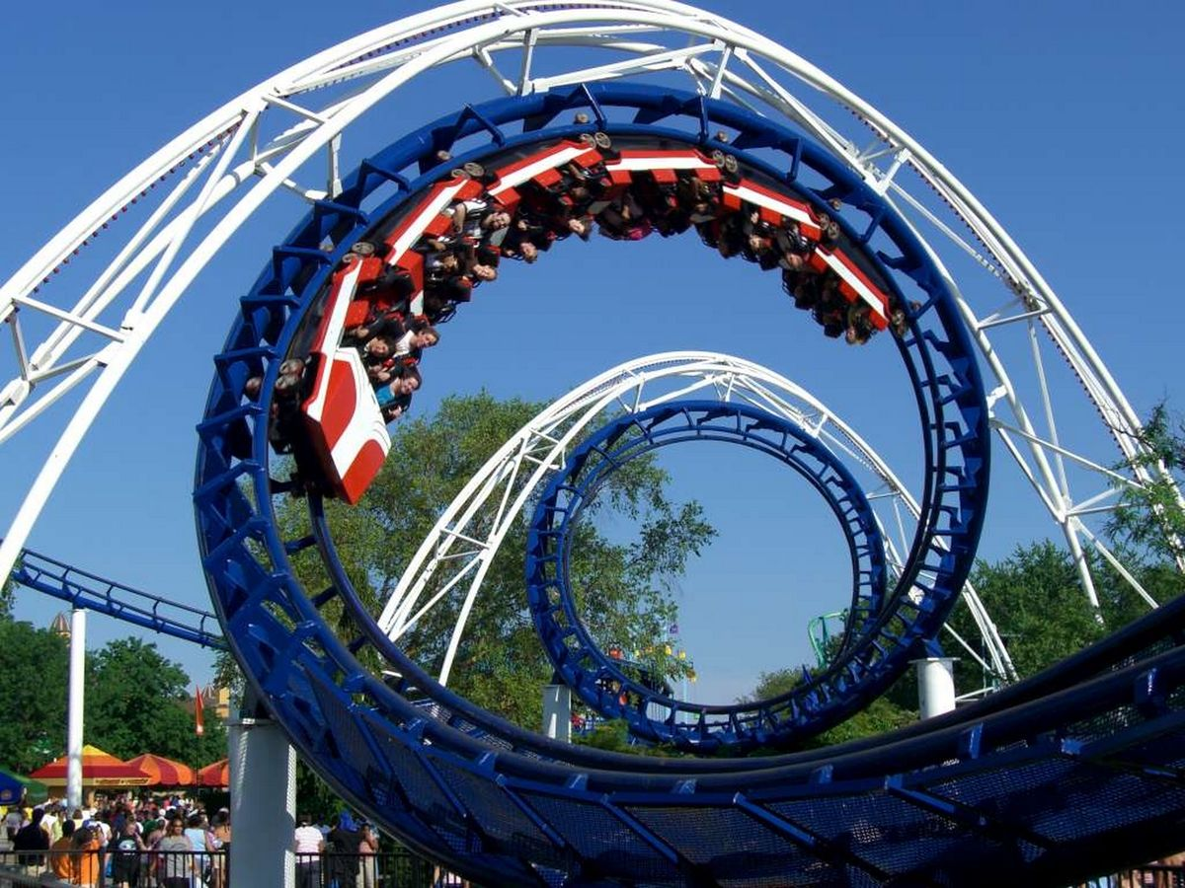
What to Look For..
Saying or doing things without thinking or without regard for safety (thrill seeking or sensation seeking behaviors)

Slide 5
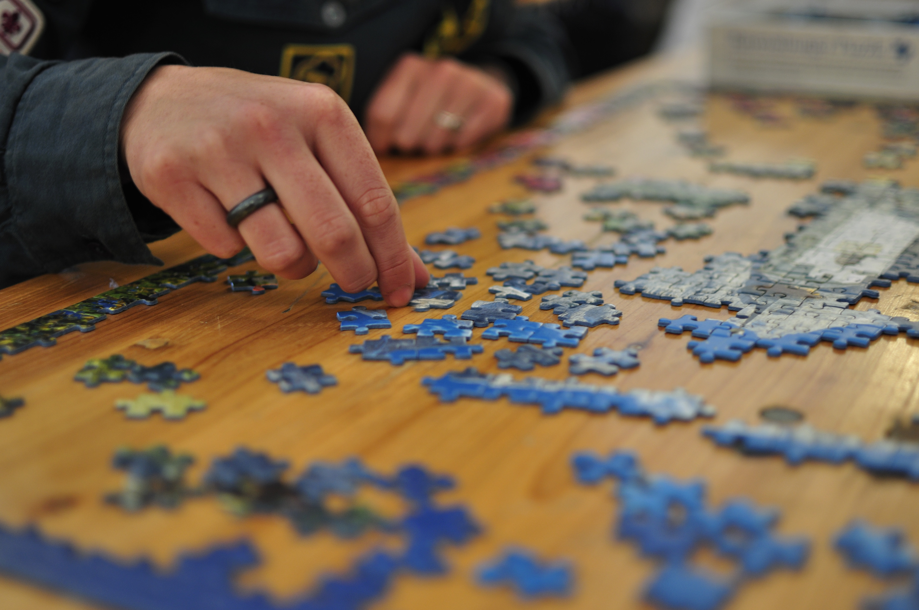
What to Look For..
Trouble knowing when to stop an activity

Slide 6

What to Look For..
Difficulty following directions

Slide 7

What to Look For..
Difficulty in managing finances (budgeting)

Slide 8

What to Look For..
Sexual promiscuity/irritability/temper outbursts

Slide 9

What to Look For..
Controlling or disrupting conversations

Slide 10
Accommodations for Impulsivity
Stop -> Think -> Act!
When you notice yourself acting on the first thing that pops into your mind, STOP and count to 3 while you think about the possible outcomes of what you are about to do

Slide 11

Accommodations for Impulsivity
Utilize breathing techniques such as breathing in through your nose, hold your breath for 6 seconds, and then breathe out through your mouth

Slide 12
Accommodations for Impulsivity
If you find yourself disrupting conversations, try:
  silently repeating the question(s) to yourself before offering an answer and/or…
  bring a notepad with you to write down your thoughts as they pop into your head

Slide 13

Accommodations for Impulsivity
Take frequent physical brain breaks

Slide 14

Accommodations for Impulsivity
Write down step-by-step instructions or create a checklist to help yourself complete tasks or instructions

