Slide 1
Defining Memory
Memory is the brain’s ability to retain previously experienced sensations, information, and ideas.
Memory impairment makes it difficult to recall, organize, or process information.

Slide 2
Discussion
How can TBI affect memory?
Notes:
Examples include: entering a room and forgetting why you went in there, becoming distracted in the middle of tasks and failing to complete them, being unable to remember the name of a new friend, failing to remember to complete a task you were asked to complete earlier that day, not being able to remember appointments or conversations).

Slide 3
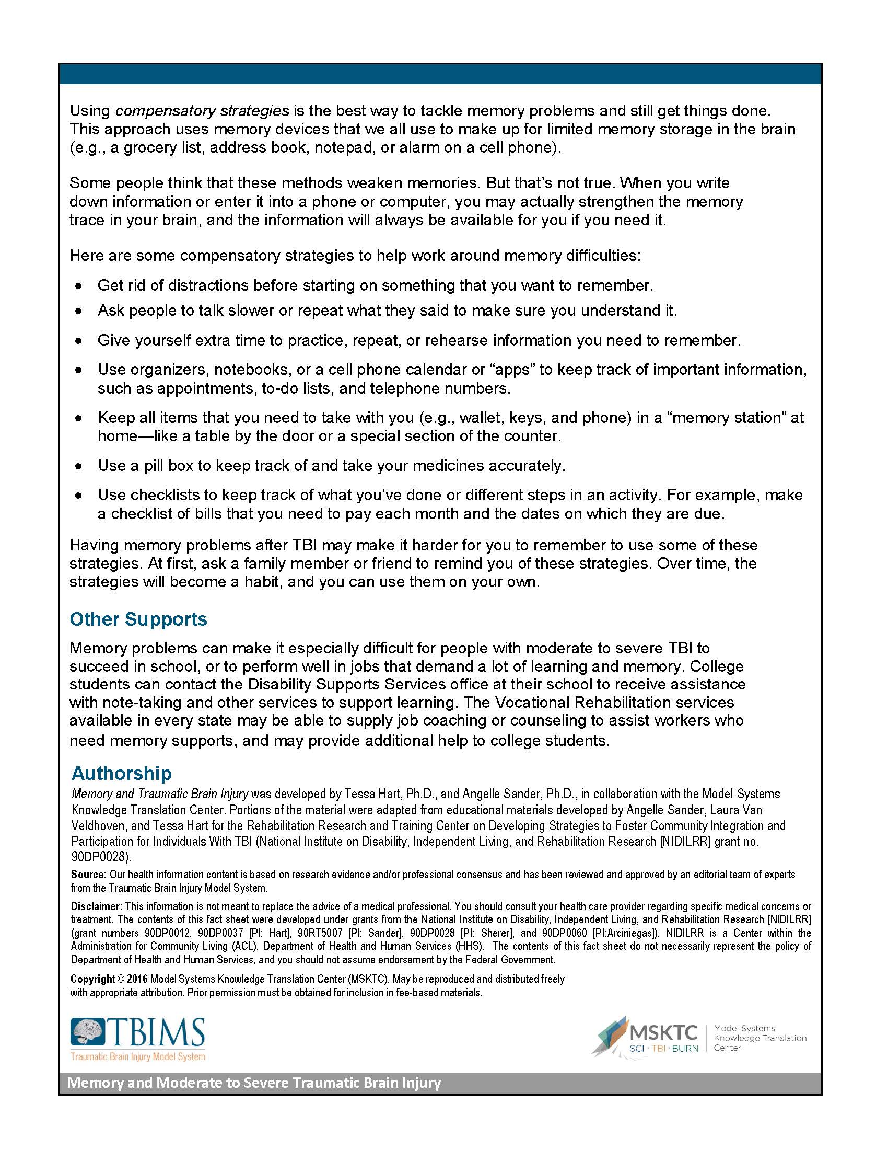
Turn to…

Slide 4
Discussion
Do some of these symptoms present themselves in your daily life?
Does anyone want to share some personal examples of experiencing these symptoms?

Slide 5
Turn to…
Do any of you use any of these strategies already?
Which strategies do you use?
How have they been effective?
How often did you have to practice them?

