Slide 1
Memory
Following a brain injury

Slide 2
Defining Memory
Memory is the brain’s ability to retain previously experienced sensations, information, and ideas.
Memory impairment makes it difficult to recall, organize, or process information.

Slide 3
Memory
Attention
Memory
Processing
Executive Function
Metacognition/
Awareness
Categorization
Memory impairments can arise from difficulty in the encoding, storage or retrieval of information.
Encoding
Perceived information is put in a context that can be stored
Storage
Stabilization of a memory
Retrieval
The search for a memory or activation of a memory
Memory
Notes:
Difference between short term memory and working memory
Short term is passive; Working is active
Very complex process-as part of sensory input coming in our sensory memory is short term information about that sense; ex. My toes are cold or that hurt! Is this something that needs to be dealt with?
Short term-memory that you have for a few hours or days…why we are waiting to see if this is important (breakfast, what you are going to wear that day)-where we store ongoing info in case we need it
Working memory-information that is short term memory while it is processing
Short term is passive; Working is active
For my presentation next week I want my blue shirt; now what info for the clothing memory of the last few days goes into my working memory from my short term
Is this information worth storing for the long term? For example: ate yogurt and got sick, then might move to long term so that we remember and not eat it
Long term-decides that you need that information long term and then retrieving it
Is there “fall down” with memory a problem with active working, or passive short term? They can’t remember passive info so….
Difficulty with retrieval of new memories?

Slide 4
Memory Processes
Attention
Memory
Processing
Executive Function
Metacognition/
Awareness
Categorization
Hearing
Vision
Taste
Touch
Smell
Rehearsal
Sensory Memory
Short Term Memory
Working Memory
Long Term Memory
Retrieval
Holds sensory information for a few seconds after perception
Enables recall of information lasting a few minutes to hours
Temporary storage and active processing of information
Permanent consolidation and storage of information
Notes:
Difference between short term memory and working memory
Short term is passive; Working is active

Slide 5
What to Look For..
Inconsistent with steps of tasks or daily activities

Slide 6
What to Look For..
Difficulty recalling previously learned information

Slide 7
What to Look For..
Difficulty learning new information

Slide 8
What to Look For..
Organizing several pieces of information

Slide 9
What to Look For..
May appear inattentive, mentally foggy, forgetful

Slide 10
What to Look For..
Lacking follow through with activities or instructions

Slide 11
Accommodations for Memory
Keep important items such as keys, wallet, papers, in one designated location

Slide 12
Accommodations for Memory
Set reminders for yourself
Notes:
4 is the ideal number! Less, but no more than 4 steps when possible!

Slide 13
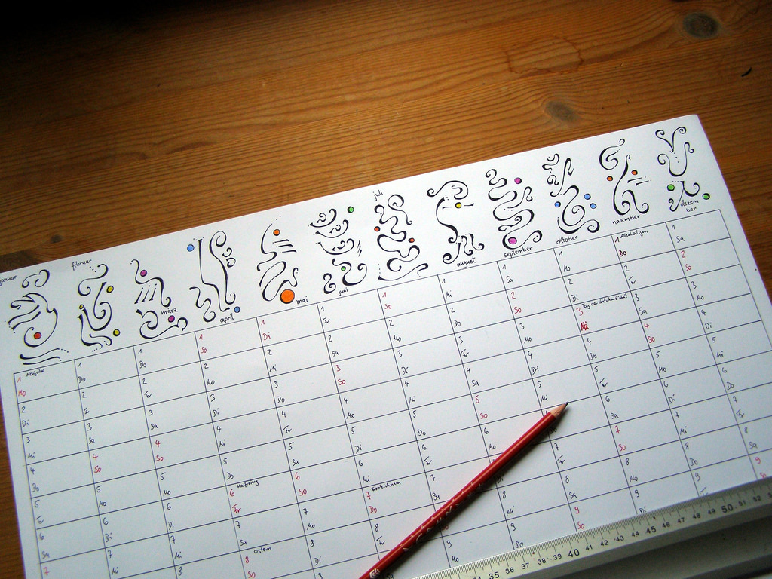
Accommodations for Memory
Write things down in more than one location such as on a paper calendar or in your phone
Notes:
4 is the ideal number! Less, but no more than 4 steps when possible!

Slide 14
Accommodations for Memory
Keep a journal. At the end of the each day, write down what you accomplished and what you would like to accomplish the next day

Slide 15
Accommodations for Memory
Try learning a new skill or language to improve working memory

Slide 16
Accommodations for Memory
Label items in your home
Cupboards
Rooms
perishable foods with the date when it was opened/prepared

Slide 17
Accommodations for Memory
Schedule recurring appointments for the same day and time each week

Slide 18
NDBIN Memory Resources
Notes:
https://www.ndbin.org/assets/4115-17614/info-needed-for-providers.pdf

Slide 19
NDBIN Memory Resources
Notes:
https://www.ndbin.org/assets/4261-18273/weekly-meal-plan.pdf

Slide 20
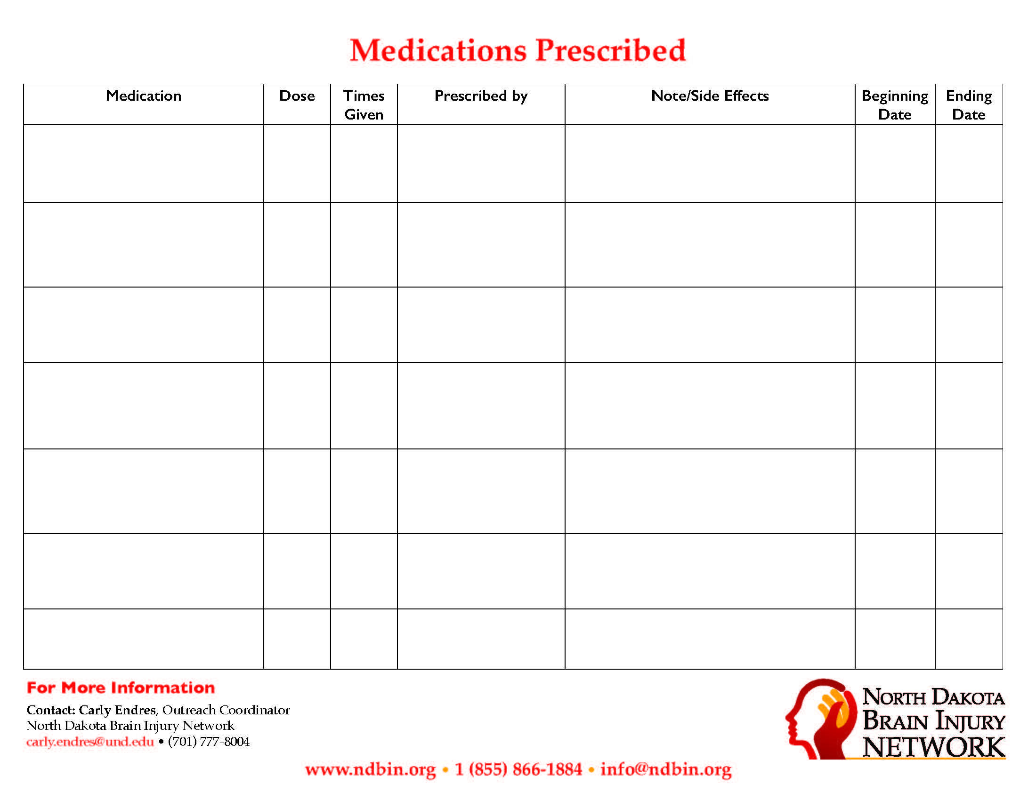
NDBIN Memory Resources
Notes:
https://www.ndbin.org/assets/4114-17612/medication-prescribed.pdf

Slide 21
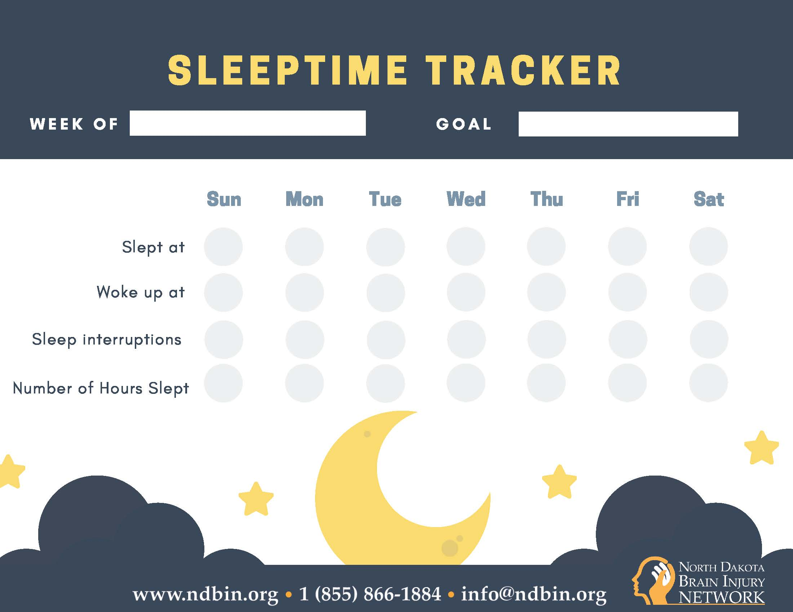
NDBIN Memory Resources
Notes:
https://www.ndbin.org/assets/4261-18284/sleep-tracker.pdf

Slide 22
Do not push yourself too hard!

