Slide 1
Mental Inflexibility
Following a brain injury

Slide 2
Defining Mental Inflexibility
Mental inflexibility is the inability to respond to changes, such as thinking about multiple ideas at once or switching between thoughts.

Slide 3

What to Look For..
Difficulty thinking/reacting in the moment

Slide 4
What to Look For..
Challenges adjusting to new or unexpected tasks/activities

Slide 5
What to Look For..
Challenges understanding another's perspective

Slide 6

What to Look For..
May be argumentative, uncooperative, or stubborn

Slide 7
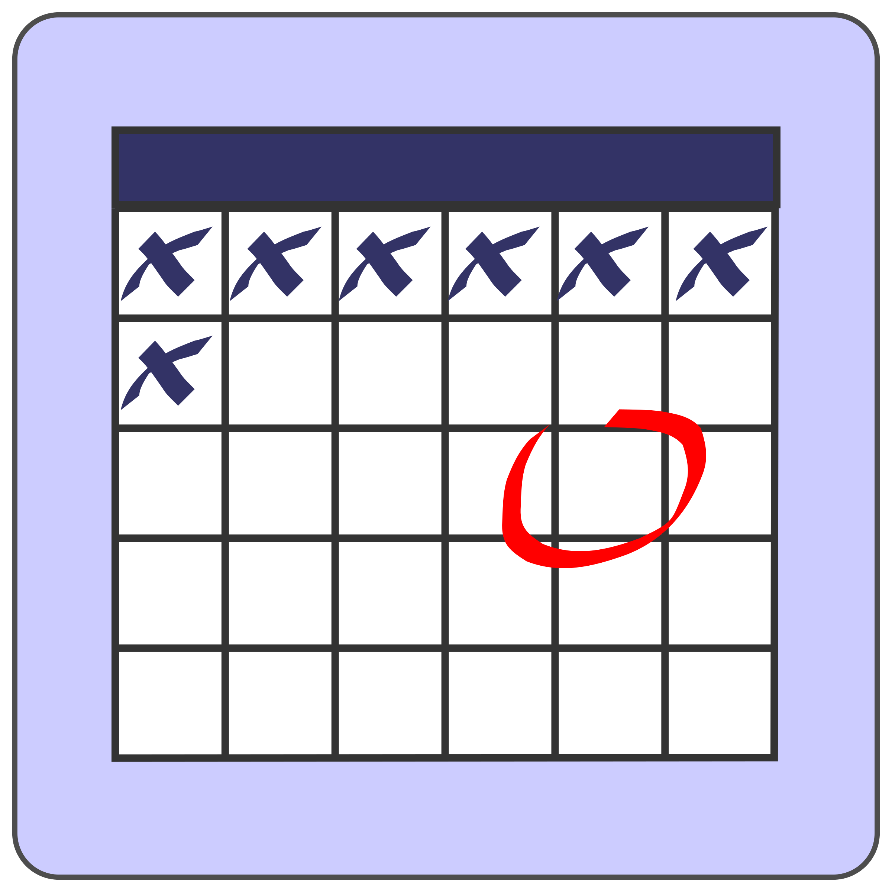
Accommodations for Mental Inflexibility
When planning, leave extra time before due dates and set reminders on items like phone, calendar, or note pads

Slide 8

Accommodations for Mental Inflexibility
Write out the steps to tasks and cross steps off as you complete them

Slide 9

Accommodations for Mental Inflexibility
Write down pros and cons, considering short and long term consequences for actions

Slide 10

Accommodations for Mental Inflexibility
Try new things, like making a new friend, tasting a new food, changing your routine, or learning a new dance

Slide 11

Accommodations for Mental Inflexibility
Make time to exercise

Slide 12
Embrace change!

