Slide 1
Organization
Following a brain injury

Slide 2
Defining Organization
Organization is the ability to use your time, energy, or resources in a helpful way to finish goals or tasks.

Slide 3
What to Look For..
Often late for appointments/misses important deadlines (e.g., paying bills, completing paperwork, etc.)

Slide 4
What to Look For..
Not taking medications correctly

Slide 5
What to Look For..
Loses track of time or feeling unsure of what day it is

Slide 6
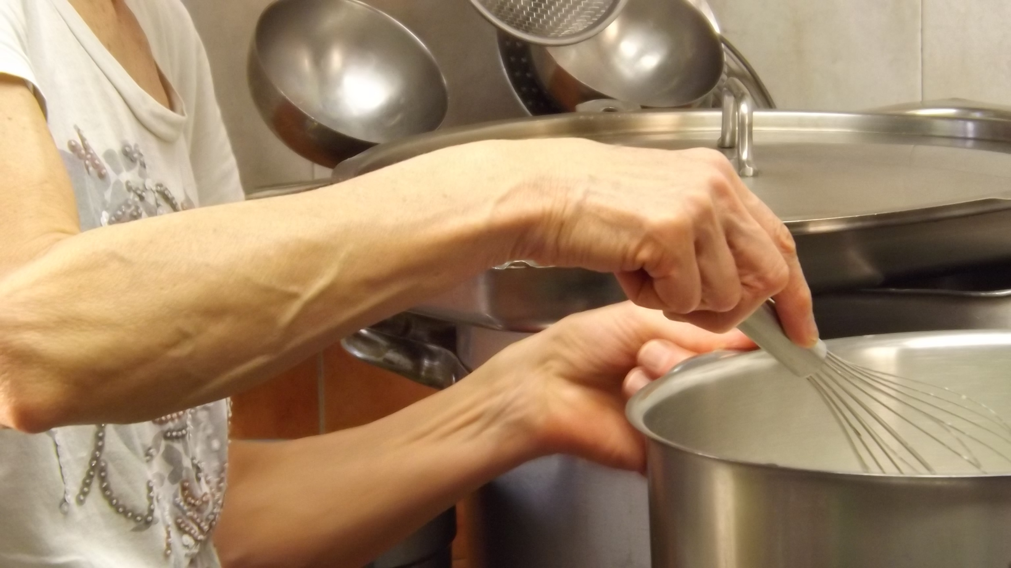
What to Look For..
Trouble completing tasks that require multiple steps in a particular order (such as laundry or cooking)

Slide 7
What to Look For..
Jumps from activity to activity without completion/gives up easily on tasks

Slide 8
Accommodations for Organization
Use a notebook, planner, or digital calendar and reminder apps for scheduling. Review weekly and monthly schedules frequently.

Slide 9
Accommodations for Organization
Use a system of organization for tasks such as important events, bill due dates, and other deadlines

Slide 10
Accommodations for Organization
Set up a routine by asking that your regular appointments be scheduled on the same day and at the same time

Slide 11
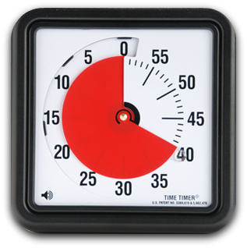
Accommodations for Organization
To help switch between tasks, set a timer or use a watch to alert yourself when to get ready for your next task

Slide 12
Accommodations for Organization
Break tasks down into smaller, simpler steps and cross off each step as it is completed (in order of priority)

Slide 13
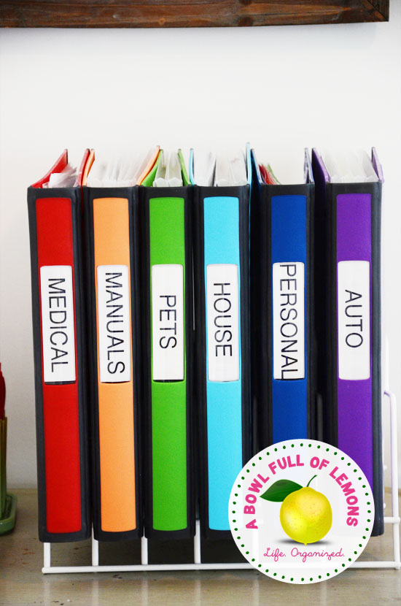
Accommodations for Organization
Keep all items you need to take with you such as wallet, purse, keys, phone in one spot in your home

Slide 14
NDBIN Organization Resources
Notes:
https://www.ndbin.org/assets/4115-17614/info-needed-for-providers.pdf

Slide 15
NDBIN Organization Resources
Notes:
https://www.ndbin.org/assets/4261-18273/weekly-meal-plan.pdf

Slide 16
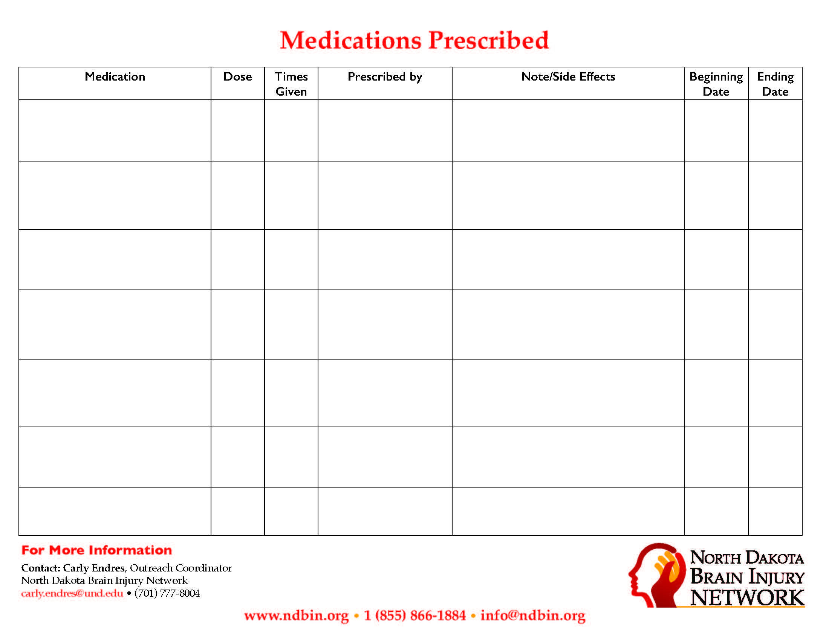
NDBIN Organization Resources
Notes:
https://www.ndbin.org/assets/4114-17612/medication-prescribed.pdf

