Slide 1
Self-Awareness
Following a brain injury

Slide 2
Defining Self-Awareness
The ability to assess one's own abilities and limitations. Individuals with brain injury may not recognize changes in behavior or personality.

Slide 3

What a lack of self-awareness can look like…
Difficulty recognizing a problem while it is happening

Slide 4
What a lack of self-awareness can look like…
Difficulty understanding why rehabilitation therapies are needed

Slide 5
What a lack of self-awareness can look like…
Difficulty putting goals and strategies into action

Slide 6
What a lack of self-awareness can look like…
Difficulty generalizing knowledge from one situation to another

Slide 7
What a lack of self-awareness can look like…
Difficulty monitoring your progress

Slide 8
What a lack of self-awareness can look like…
Not following recommendations of providers

Slide 9
Accommodations for Self-Awareness
Learn how to use safe “supported risk taking” techniques from providers

Slide 10
Accommodations for Self-Awareness
Work with providers to develop effective problem solving techniques

Slide 11
Accommodations for Self-Awareness
Ask for realistic feedback from members of your support system

Slide 12

Accommodations for Self-Awareness
Use a memory notebook, video reviews, or device (e.g.,cellphone) to track progress and setbacks

Slide 13
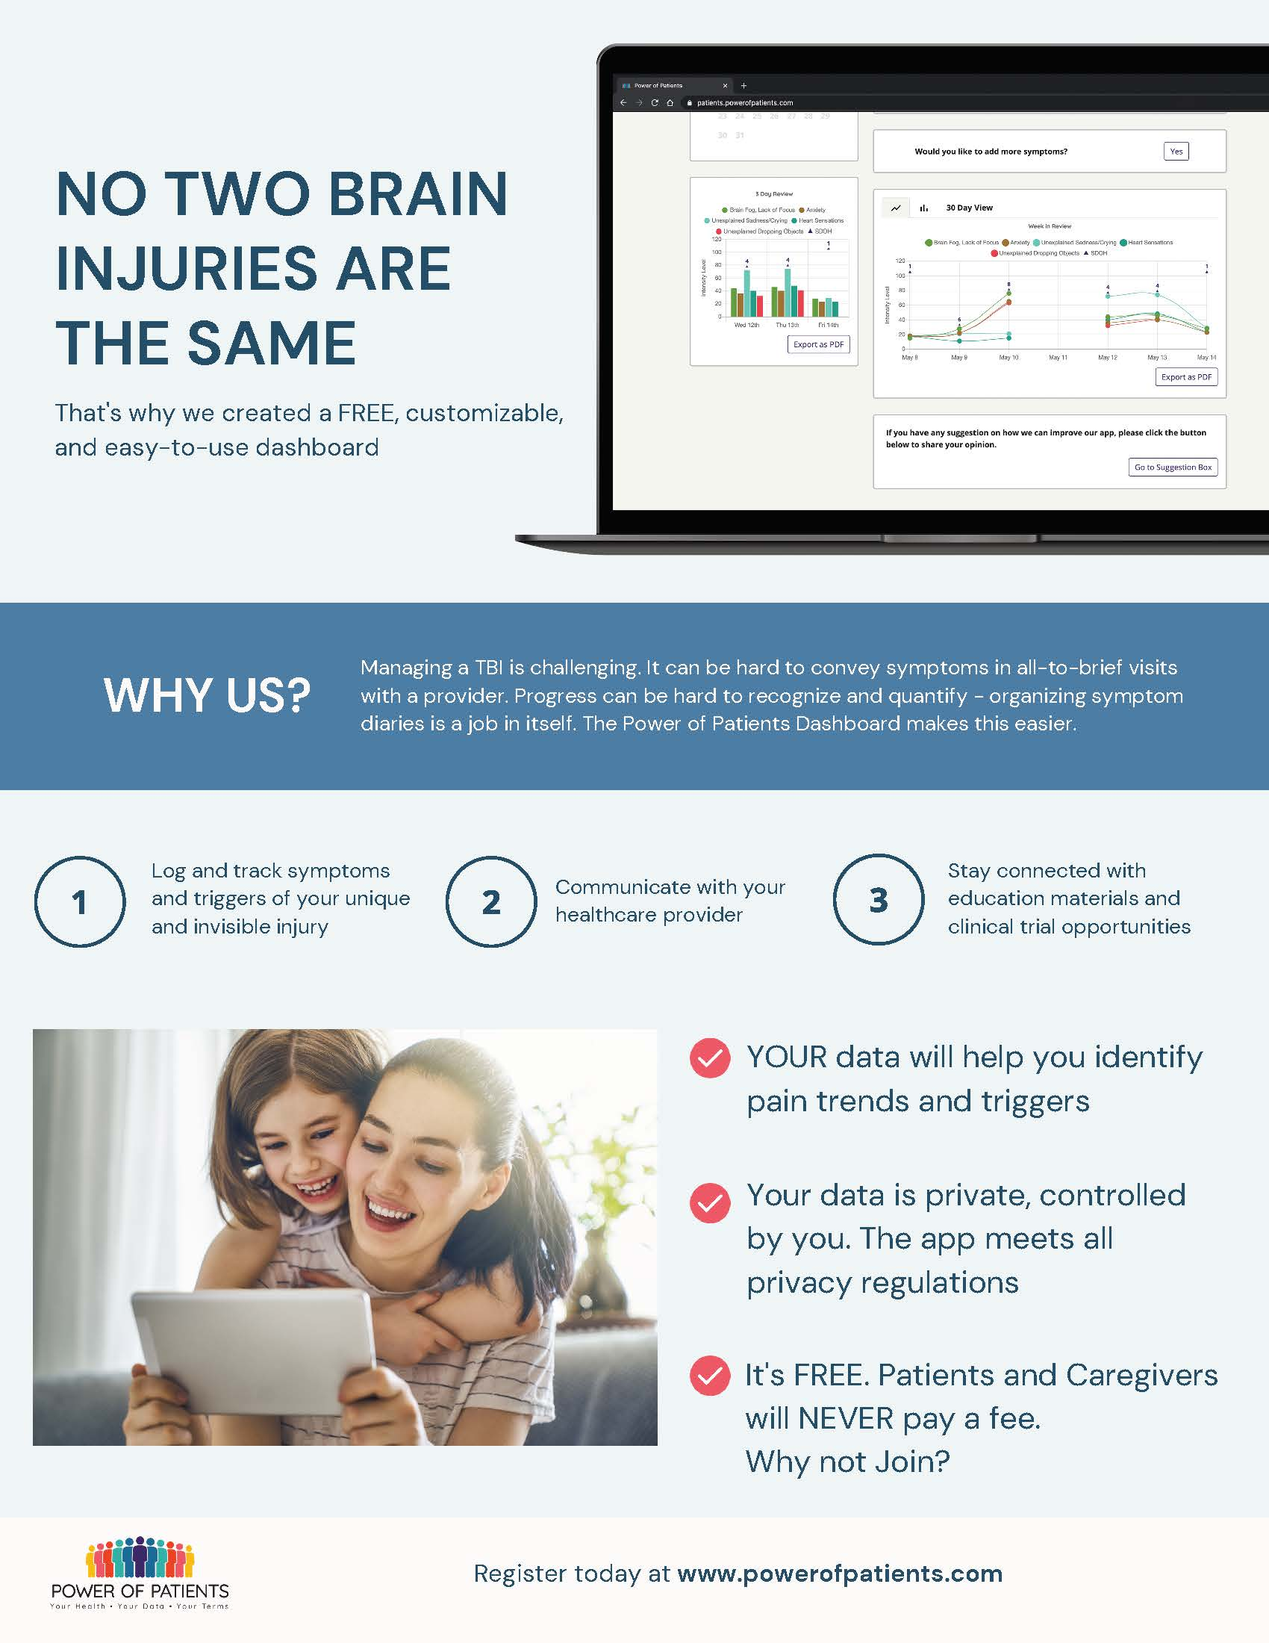
Power of Patients

Slide 14
Accommodations for Self-Awareness
Consider participating in individual therapy to help you process the changes in your life

Slide 15
Time and Routine
Adjustments and change take time!
Establish routine to allow for multiple repetitions when learning something new
New skills will NOT be attained overnight
Notes:
Source, Mayo Clinic: https://www.mayoclinic.org/healthy-lifestyle/consumer-health/in-depth/mindfulness-exercises/art-20046356

Slide 16
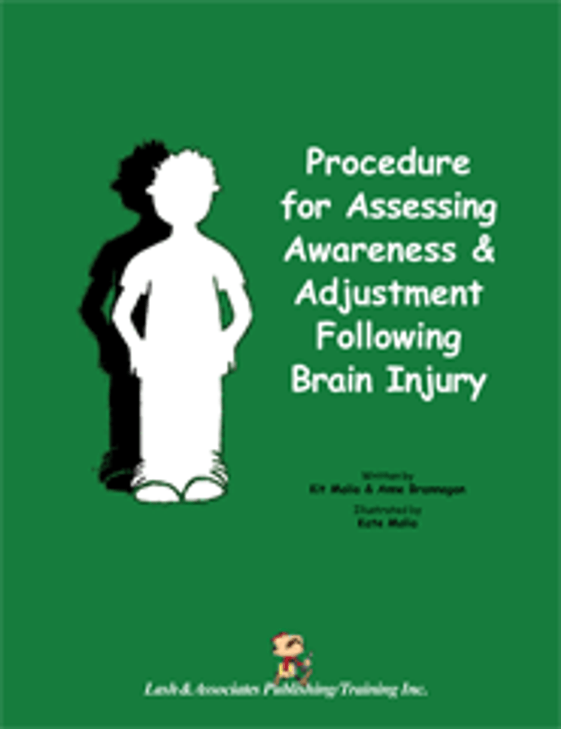
Resources for Self-Awareness

