Slide 1
TBI Symptom Education
Thinking/remember
Physical
Emotional/mood
Sleep
Notes:
1. TBIs, like any kind of illness or injury, have certain kinds of associated symptoms. 2. Many of these symptoms fall into one of four categories: • Thinking/remembering • Physical • Emotional/mood • Sleep

Slide 2
Executive Functioning
Refers to multi-tasking, making decisions, starting/stopping tasks and activities, and processing input from your environment
All these areas can be affected

Slide 3
Other symptoms
Issues staying focused on certain tasks
Difficulty controlling impulses
Indecisiveness in situations
Poor long-term planning

Slide 4
Discussion
In what ways can brain injuries look like other things?
Does having a brain injury change who we are?
Does having a brain injury define us?
Notes:
These symptoms are very common in other medical or psychological issues. In what way can they sometimes look like other things? (If not mentioned, bring up other issues that might have overlapping symptoms: alcohol and drug abuse, dementia, bipolar disorder, etc.). Does having a TBI change who we are? Does it define us? Facilitators should think of examples to share (especially if the group is struggling with these questions), and may say something like: “Just as with any lifetime condition, having a TBI does influence some parts of how a person can interact with the world and function day to day. However, it is important to remember that a person is much more than their injury or illness. For example, you wouldn’t define someone with diabetes only as a diabetic and not as a person, because you would realize that there is much more to what makes them who they are. While it may be true that you are living with the effects of TBI, what is more important is that you are LIVING! You are constructing a complex life full of interesting experiences and people. Your TBI cannot and will not define you, as long as you continue to define yourself.

Slide 5
Discussion
How do we tell the difference between symptoms and other internal stimuli?
How do we explain our symptoms to ourselves and others?

Slide 6
Example Explanation
Due to an injury to my brain, I sometimes have trouble remembering things and staying on track. As a result, I may need reminders and it may take me longer to read something, or to complete tasks, than it used to. What I need from you to help me is to_____________________________________________________. I ask you to be patient with me as I learn how to function with these changes in my brain.

Slide 7
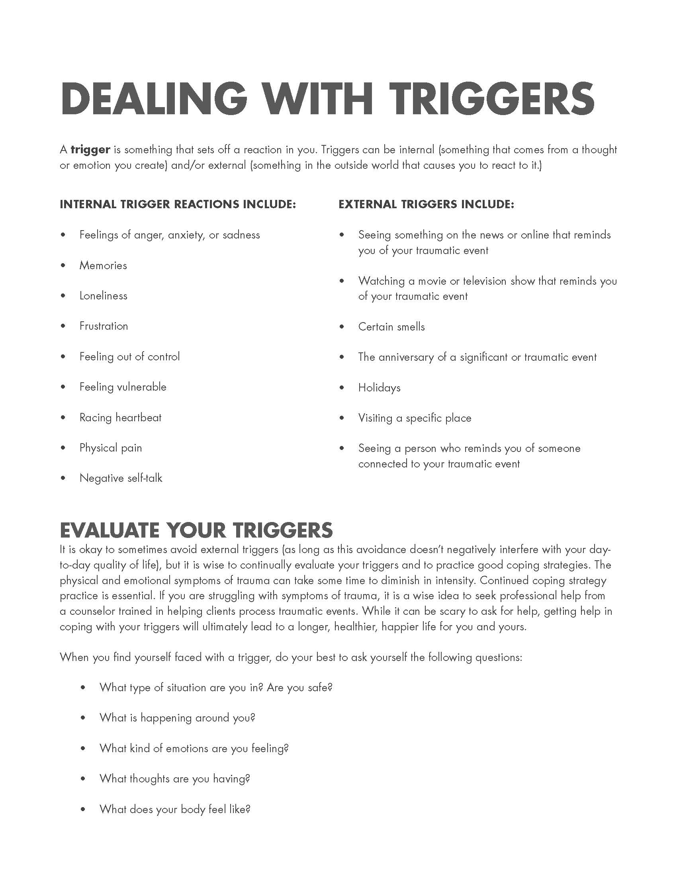
Turn to…
Partner up
with partner discuss:
*When have you noticed symptoms happening?
*What makes them better or worse?
You will report for your partner

